Slide 1
Theorem Proving
Dave Touretzky
Read R&N Ch. 9.5-9.6

Slide 2
Propositional resolution
Proof by contradiction: to prove α, assume ~α and derive FALSE.
Sound: only valid inferences are made.
Complete: if a sentence is valid, the proof will be found.
Formulas must be in CNF.
But conversion to CNF is straightforward.

Slide 3
Resolution in First-Order Logic
Resolution is more complicated in FOL due to:
Functions — can generate infinite models
Variables — must use unification to match literals
Requires standardization of variables (variable renaming) to avoid conflicts
Quantifiers
Existential quantifiers require Skolemization
Nesting order of quantifiers matters
Equality
Paramodulation and demodulation
Equational resolution

Slide 4
Converting an FOL Sentence to CNF
“Everyone who loves all animals is loved by someone.”
∀x [ [ ∀y Animal(y) ⇒ Loves(x,y) ] ⇒ ∃y Loves(y,x) ]
Scoping: y and y are different variables.

Slide 5
Step 1: Eliminate implications
∀x [ [ ∀y Animal(y) ⇒ Loves(x,y) ] ⇒ ∃y Loves(y,x) ]
∀x [ [¬ ∀y Animal(y) ⇒ Loves(x,y) ] ∨ ∃y Loves(y,x) ]
∀x [ [ ¬ ∀y ¬ Animal(y) ∨ Loves(x,y) ] ∨ ∃y Loves(y,x) ]

Slide 6
Step 2: Move ¬ inward
¬ ∀ x p becomes ∃ x ¬p
¬ ∃ x p becomes ∀ x ¬ p
∀ x [ [ ∃ y ¬(¬Animal(y) ∨ Loves(x,y)) ] ∨ [ ∃y Loves(y,x) ] ]
∀ x [ [ ∃ y ¬¬Animal(y) ∧ ¬Loves(x,y)) ] ∨ [ ∃y Loves(y,x) ] ]
∀ x [ [ ∃ y Animal(y) ∧ ¬Loves(x,y)) ] ∨ [ ∃y Loves(y,x) ] ]

Slide 7
Step 3: standardize variables
Rename the second y to z:
∀ x [ [ ∃ y Animal(y) ∧ ¬Loves(x,y)) ] ∨ [ ∃z Loves(z,x) ] ]

Slide 8
Step 4: Skolemization
Create a unique constant for each existentially quantified variable.
But the constant is a function of all other variables in its scope, so we must use Skolem functions to generate these constants.
∀x [ [ Animal(f(x)) ∧ ¬Loves(x, f(x)) ] ∨ Loves(g(x), x) ]

Slide 9
Step 5: Drop universal quantifiers
[ Animal(f(x)) ∧ ¬Loves(x, f(x)) ] ∨ Loves(g(x), x)

Slide 10
Step 6: Distribute ∨ over ∧
[ Animal(f(x)) ∨ Loves(g(x), x) ] ∧ [ ¬Loves(x, f(x)) ∨ Loves(g(x), x) ]
The sentence is now in CNF. But it’s not very readable.

Slide 11
The resolution inference rule
l₁ ∨ … ∨ l_{k} , m₁ ∨ … ∨ m_{n} ------------------------------------------------------------------------------------------------------------------------------------ SUBST(θ, l₁ ∨ … ∨ l_{i-1} ∨ l_{i+1} ∨ … ∨ l_{k} ∨ m₁ ∨ … ∨ m_{j-1} ∨ m_{j+1} ∨ … ∨ m_{n} )
where UNIFY(l_{i} , ¬m_{j}) = θ

Slide 12
Applying the binary resolution rule
Unify: [ Animal(f(x)) ∨ Loves(g(x), x) ] with [ ¬Loves(u,v) ∨ ¬Kills(u,v) ]
Use the unifier θ = { u / g(x), v / x } to produce
[ Animal(f(x)) ∨ ¬Kills(g(x), x) ]
Tricky bits:
For completeness, we must resolve all subsets of literals that are unifiable, not just pairs of literals.
Alternative is factoring: replacing two literals by one if they are unifiable.

Slide 13
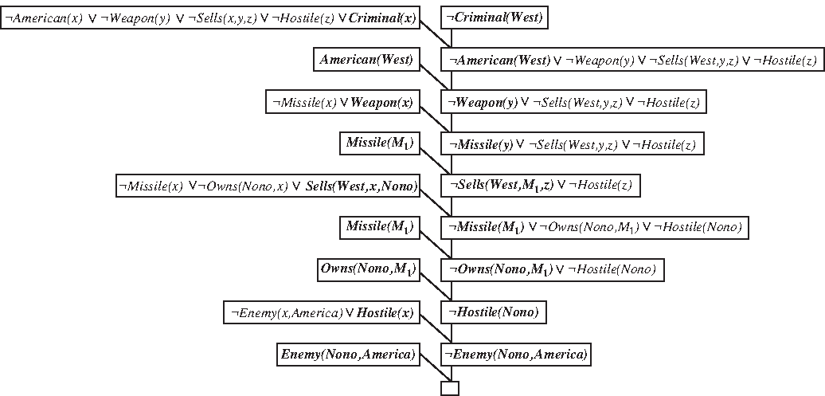
Prove that Colonel West is a criminal
Unified terms are shown in boldface.
Straight-line derivation because this is a Horn theory.
There is a contradiction but it doesn’t mention West.

Slide 14
Did curiosity kill the cat?
Everyone who loves animals is loved by someone.
Anyone who kills an animal is loved by no one.
Jack loves all animals.
Either Jack or Curiosity killed the cat.
The cat is named Tuna.
Cats are animals.
Did Curiosity kill the cat?

Slide 15
Logically, did curiosity kill the cat?
∀x [ ∀y Animal(y) ⇒ Loves(x,y) ] ⇒ ∃y Loves(y,x)
∀x [ ∃z Animal(z) ∧ Kills(x,z) ] ⇒ ∀y ¬Loves(y,x)
∀x Animal(x) ⇒ Loves(jack,x)
Kills(jack, tuna) ∨ Kills(curiosity, tuna)
Cat(tuna)
∀x Cat(x) ⇒ Animal(x)
¬Kills(curiosity, tuna)

Slide 16
Convert to CNF
Animal(f(x)) ∨ Loves(g(x), x) ¬Loves(x, f(x)) ∨ Loves(g(x), x)
¬Loves(y,x) ∨ ¬Animal(z) ∨ ¬Kills(x,z)
¬Animal(x) ∨ Loves(jack,x)
Kills(jack, tuna) ∨ Kills(curiosity, tuna)
Cat(tuna)
¬Cat(x) ∨ Animal(x)
¬Kills(curiosity, tuna)

Slide 17
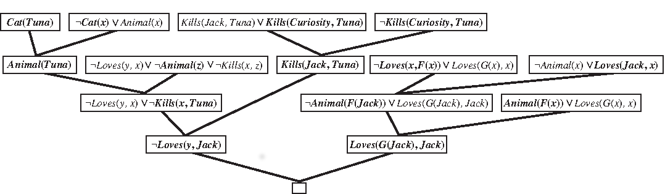
Did curiosity kill the cat?
Not a straight-line derivation because this is not a Horn theory.

Slide 18
Who killed the cat?
Goal: ∃w Kills(w, tuna)
Negated, in CNF: ¬Kills(w, tuna)
Can unify with both Kills(jack, tuna) or Kills(curiosity, tuna), so we derive a contradiction without knowing who killed tuna.

Slide 19
Who killed the cat?
Kills(jack, tuna) ∨ Kills(curiosity, tuna)
¬Kills(w,tuna)
{ w / curiosity }
Kills(jack, tuna)
{ w / jack }

Slide 20
Who killed the cat?
Solutions:
Don’t allow the query variable w to be bound more than once in a derivation. Backtrack on w until we find a value that gives the desired contradiction. Example: binding w to curiosity leaves us with Kills(jack, tuna), which resolves with the other clauses to yield a contradiction.
Create an “answer literal” to use in the query: ¬Kills(w, tuna) ∧ Answer(w). When we derive a clause containing only Answer(w) for some w, report that value as an answer to the query.

Slide 21
How to handle equality
Three approaches:
Axiomatize
Inference rules
Extended unification

Slide 22
Axiomatizing equality
∀x x = x ∀x,y x=y ⇒ y=x ∀x,y,z x=y ∧ y=z ⇒ x=z
For all predicates P, Q, ...: ∀x,y x=y ⇒ (P(x) ⇔ P(y)) ∀w,x,y,z w=x ∧ y=z ⇒ (Q(w,y) ⇔ Q(x,z)) ...
For all functions f, g, ...: ∀x,y x=y ⇒ (f(x) = f(y)) ∀w,x,y,z w=x ∧ y=z ⇒ (g(w,y) = g(x,z)) ...
This produces correct equality reasoning, but it generates a huge number of conclusions, most of which will not be useful.

Slide 23
Inference rules for equality: demodulation
x=y , m₁ ∨ … ∨ m_{n} ----------------------------------------------------- SUB(SUBST(θ,x), SUBST(θ,y), m₁ ∨ … ∨ m_{n})
where UNIFY(x,z) = θ and z appears somewhere in m_{i}. SUB(x,y,m) means replace x with y everywhere that x occurs in m.
Example: father(father(x)) = paternal_grandpa(x) Birthdate(father(father(bella)), 1926)
Using θ = { x / bella } we can derive: Birthdate(paternal_grandpa(bella), 1926)

Slide 24
Inference rules for equality: paramodulation
l₁ ∨ … ∨ l_{k} ∨ x=y , m₁ ∨ … ∨ m_{n} ---------------------------------------------------------------------- SUB(SUBST(θ,x), SUBST(θ,y), l₁ ∨ … ∨ l_{k} ∨ m₁ ∨ … ∨ m_{n})
Handles non-unit clauses where one of the terms is an equality.
Example: from P(f(x,b), x) ∨ Q(x) and f(a,y)=y ∨ R(y)
We have θ = { x / a, y / b}
We derive: P(b,a) ∨ Q(a) ∨ R(b)
Paramodulation yields a complete inference procedure.

Slide 25
Equality via extended unification
The third way to handle equality is to modify the unification algorithm to allow unification of expressions that are provably equal.
For example, equational unification could allow (1+2) to unify with (2+1) using the empty substitution.
This approach is used in CLP (Constraint Logic Programming) systems.

Slide 26
Resolution strategies
Unit preference
Set of support
Input resolution
Subsumption

Slide 27
Unit preference strategy
Which clauses should we resolve first?
If we resolve a unit clause with another clause, the result is always a shorter clause. Since we’re trying to derive a contradiction (empty clause), shorter is better.
So choose unit clauses first.
Unit resolution requires a unit clause in every step. Incomplete in general, but complete for Horn theories, where it resembles forward chaining.

Slide 28
“Set of support” strategy
Require that every resolution step involve at least one element from a special “set of support”. New resolvents are added to this step.
Provides a way to focus attention on formulas relevant to the goal. Inference will be incomplete if the set is not chosen carefully.
If the set of support starts out with just the negation of the query, it generates a goal-directed proof tree that may be easier for humans to understand.

Slide 29
Input resolution strategy
The “input set” consists of the sentences of the KB plus the query.
The input resolution strategy requires every resolution step to include a sentence from the input set.
Complete for Horn theories.
Incomplete in general.
In linear resolution we allow P and Q to be resolved together if either P is in the original KB or P is an ancestor of Q in the proof tree.
Linear resolution is complete.

Slide 30
Subsumption strategy
Eliminate all sentences that are subsumed by (i.e., are more specific than) a sentence already in the KB.
If we have P(x) in the KB, don’t add P(a) or P(a) ∨ Q(b).
The goal is to keep the size of the KB small, which reduces the search space.
In HW4 we will explore a version of this idea.

Slide 31
Uses of theorem proving
Prove mathematical theorems
Design of digital circuits
Verification of complex hardware, including entire CPUs.
“Automatic programming”: synthesizing a program based on a formal specification
Not practical for general programs
Works in specialized areas such as scientific computing code (e.g., vectorization)
“Hand-guided” synthesis has been used successfully for algorithm design

Slide 32
Theorem proving at Intel
These slides are based on a presentation by John Harrison of Intel: https://www.cl.cam.ac.uk/~jrh13/slides/arw-04apr02/slides.pdf
The 1994 FDIV (floating point division) bug in the Intel Pentium processor cost the company $500 million.
Today new products are developed more quickly: less time to find bugs.

Slide 33
Increased complexity makes bugs more likely
John Harrison (Intel):
A 4-fold increase in pre-silicon bugs in Intel processor designs per generation.
Approximately 8000 bugs introduced during design of the Pentium 4.
Pre-silicon bug detection rates are now at least 99.7%.
But that still leaves ~ 24 uncaught bugs.

Slide 34
Approaches to formal verification of chips
Symbolic simulation
Temporal logic model checking (see Ed Clark’s Turing Award)
General theorem proving
Intel uses a combination of these techniques.
Hybrid theorem prover that includes mathematical knowledge about floating point representations.

